Slide 1

Getting started with CSS
Flexbox
Khurram Raheel

Slide 2
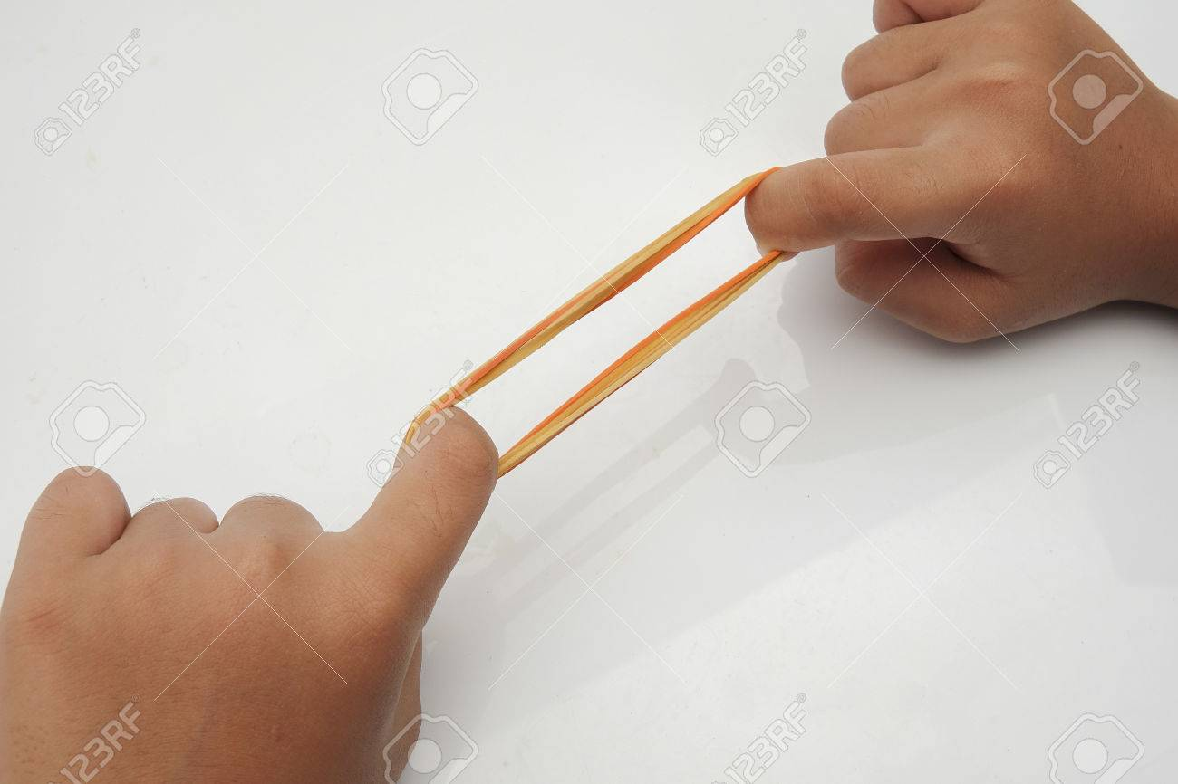
Why flexbox?
A W3C standard for making a layout which is entirely flexible within the given space available.

Slide 3

Direction agnostic
A flexbox is direction-agnostic as opposed to the regular layouts (block which is vertically-based and inline which is horizontally-based). While those work well for pages, they lack flexibility (no pun intended) to support large or complex applications (especially when it comes to orientation changing, resizing, stretching, shrinking, etc.).

Slide 4

Getting started with flexbox

Slide 5
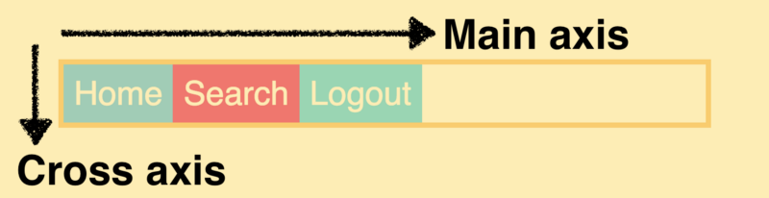
Flexbox directions

Slide 6
Flexbox working
Container display:flex
Child

Slide 7
Advantages
Both vertical and horizontal centering without any hacks and workaround solutions
Altering order of elements inside layout without affecting markup and document structure (using either order property or flex-flow).

Slide 8

Assignment#1

Slide 9
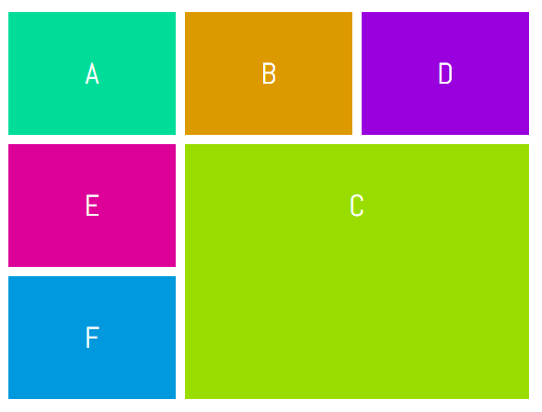
CSS grid
CSS Grid Layout excels at dividing a page into major regions or defining the relationship in terms of size, position, and layer, between parts of a control built from HTML elements.

Slide 10

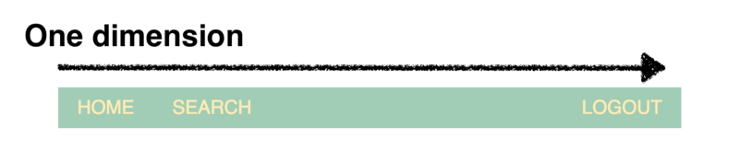
Difference between grid and flexbox
Flexbox is made for one dimensional layouts and Grid is made for two dimensional layouts.
flex-direction

Slide 11
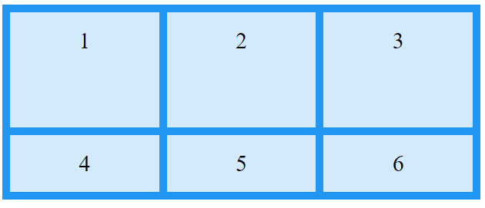
Create a grid
container{
display: grid; grid: height of rows / width of columns;
}
container{ grid: 100px 200px / 100 px 200px auto; }
//We can also use grid-template-columns and grid-template-rows

Slide 12
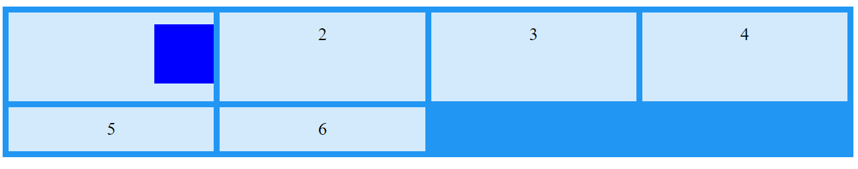
Assignment#2

